Slide 1

Physics 1
Prepared by Engr. Philip Jayson L. Lestojas

Slide 2
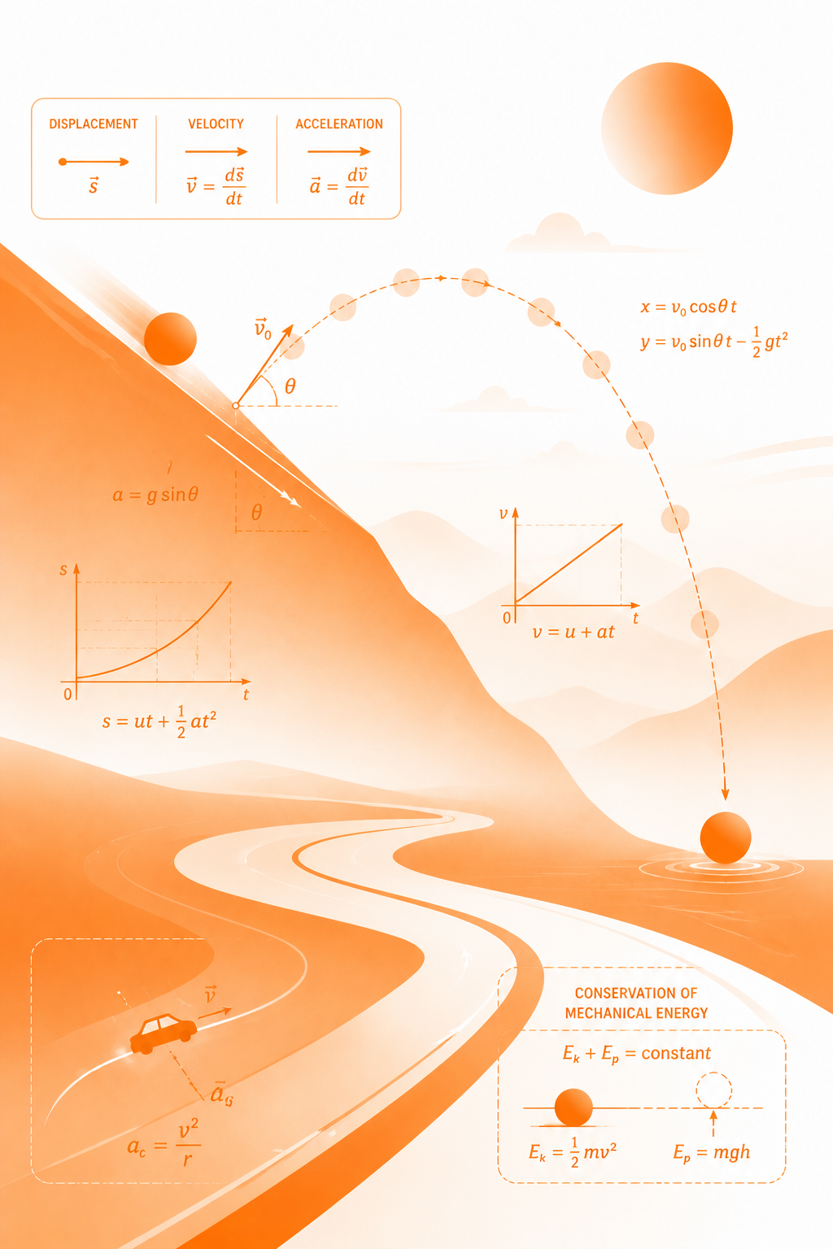
Learning Competency
Derive the four kinematic equations and their various forms through algebraic methods to solve various cases of uniformly accelerated motion (horizontal and vertical).
Physics 1
Prepared by Engr. Philip Jayson L. Lestojas
Notes:
Title: CALCULATING MOTION IN ONE DIMENSION

Slide 3
Learning Objectives
1
Derive the four kinematic equations of uniformly accelerated motion algebraically from the definitions of displacement, velocity, and acceleration.
2
Apply the four kinematic equations to solve real-world problems involving uniformly accelerated horizontal motion.
3
Value the importance of correct sign conventions and precise reasoning when interpreting the velocity and acceleration of everyday moving objects.
Physics 1
Prepared by Engr. Philip Jayson L. Lestojas

Slide 4
The Language of Motion
Symbol | Meaning
x_{o} or x_{i} | initial position
x or x_{f} | final position
v_{o} or v_{i} | initial velocity
v or v_{f} | final velocity
t | elapsed time
a | acceleration
Physics 1
Prepared by Engr. Philip Jayson L. Lestojas
Notes:
"If I told you a car was '30 meters away,' would that be enough information?" It isn't — away from what?
Emphasize that the "particle model" is a simplification — we don't care about the car's length or the driver's arm movements, only where one representative point on the car is at each moment.

Slide 5
Imagine you’re watching a car move. Its speedometer shows:
Time (s) | Velocity (m/s)
0 | 0
1 | 2
2 | 4
3 | 6
4 | 8
Physics 1
Prepared by Engr. Philip Jayson L. Lestojas
Notes:
"If I told you a car was '30 meters away,' would that be enough information?" It isn't — away from what?
Emphasize that the "particle model" is a simplification — we don't care about the car's length or the driver's arm movements, only where one representative point on the car is at each moment.

Slide 6
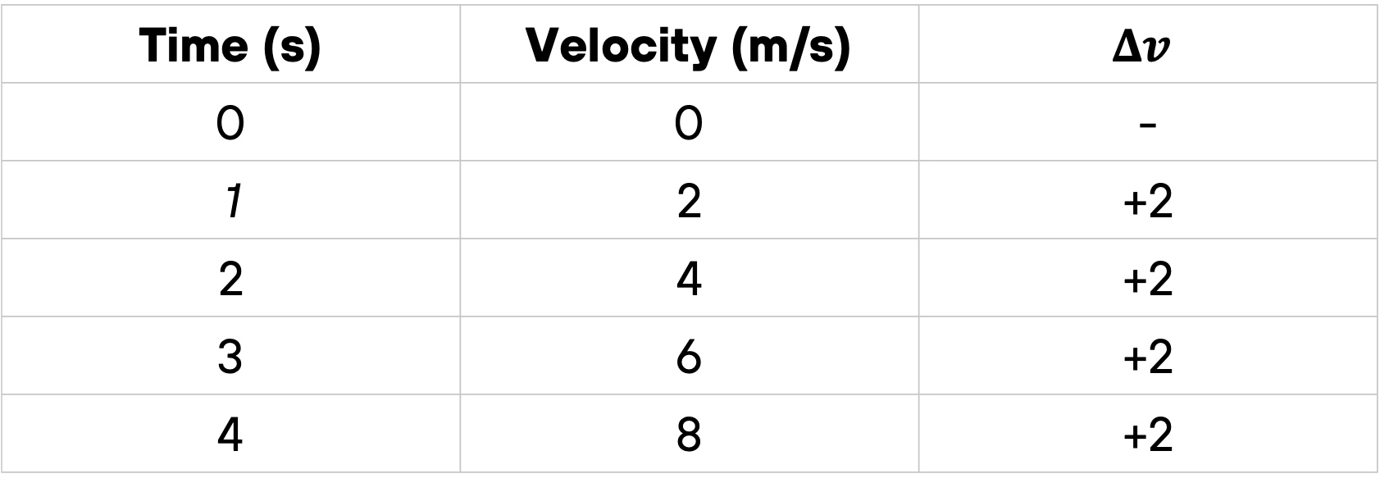
Imagine you’re watching a car move. Its speedometer shows:
Time (s) | Velocity (m/s) | $$Δv$$
0 | 0 | -
1 | 2 | +2
2 | 4 | +2
3 | 6 | +2
4 | 8 | +2
Physics 1
Prepared by Engr. Philip Jayson L. Lestojas
Notes:
"If I told you a car was '30 meters away,' would that be enough information?" It isn't — away from what?
Emphasize that the "particle model" is a simplification — we don't care about the car's length or the driver's arm movements, only where one representative point on the car is at each moment.

Slide 7
What Makes Acceleration “Uniform”
Acceleration is uniform (or constant) when velocity changes by the same amount in every equal time interval.
This is not the same as constant velocity — the object's speed is changing, but the rate of that change never does.
Physics 1
Prepared by Engr. Philip Jayson L. Lestojas
Notes:
Walk through the formula slowly: subtract where you started from where you ended. Stress that displacement is blind to the journey — if a car drives forward, backs up, and ends up exactly where it started, its displacement is zero, no matter how much ground it actually covered.

Slide 8
What Makes Acceleration “Uniform”
Drag racer launching off the line:
velocity climbs at a steady, engineered rate.
Train leaving a station:
smooth, constant push from the motor before reaching cruising speed.
Car braking for a red light:
velocity falls at a steady rate.
Physics 1
Prepared by Engr. Philip Jayson L. Lestojas

Slide 9
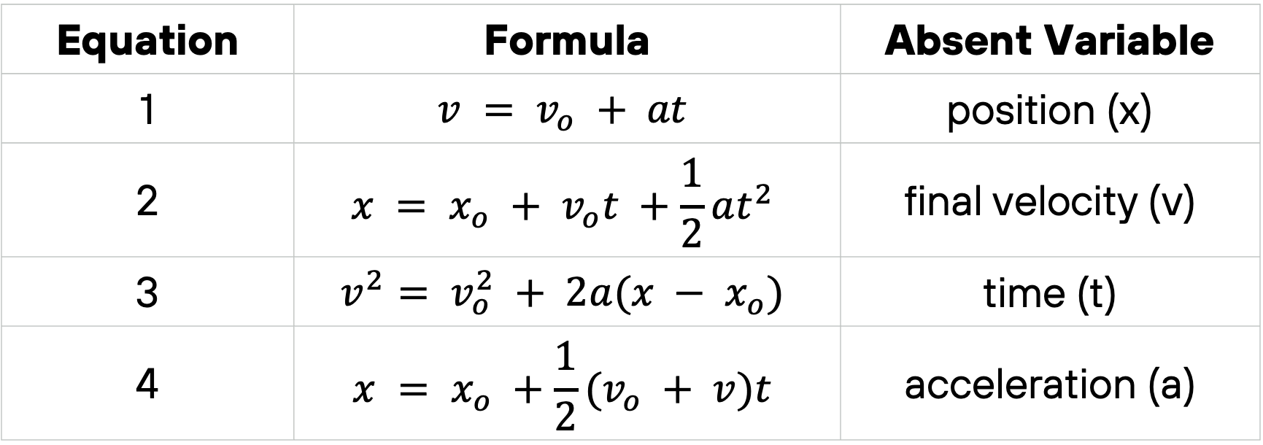
The Four Kinematic Equations
Equation | Formula | Absent Variable
1 | $$v = v_{o} + at$$ | position (x)
2 | $$x = x_{o} + v_{o}t +\frac{1}{2}at^{2}$$ | final velocity (v)
3 | $$v^{2}= v_{o}^{2} + 2a(x − x_{o})$$ | time (t)
4 | $$x = x_{o} +\frac{1}{2}(v_{o} + v)t$$ | acceleration (a)
Physics 1
Prepared by Engr. Philip Jayson L. Lestojas
Notes:
Walk through the formula slowly: subtract where you started from where you ended. Stress that displacement is blind to the journey — if a car drives forward, backs up, and ends up exactly where it started, its displacement is zero, no matter how much ground it actually covered.

Slide 10
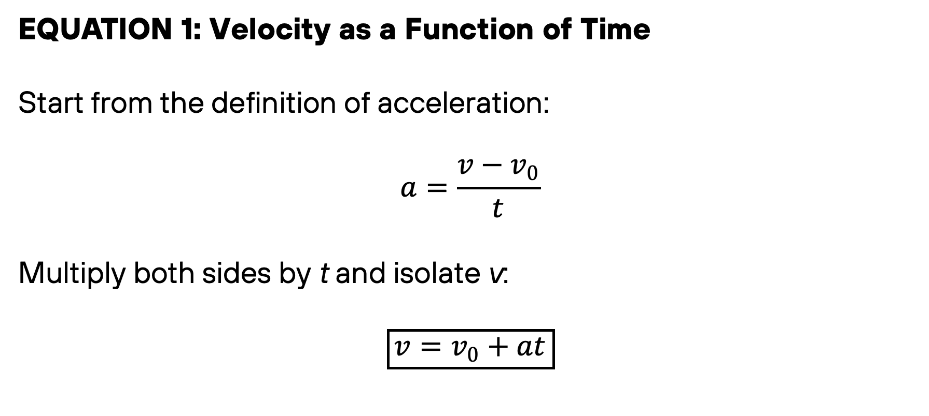
Deriving Equation 1
EQUATION 1: Velocity as a Function of Time
Start from the definition of acceleration:
$$a=\frac{v−v_{0}}{t}$$
Multiply both sides by t and isolate v:
$$\boxed{v=v_{0}+at}$$
Physics 1
Prepared by Engr. Philip Jayson L. Lestojas

Slide 11
Guided Example 1
A parcel of air moving in a straight tube with a constant acceleration of −4.00 m/s² has a velocity of 13.0 m/s at 10:05:00 a.m.
(a) What is its velocity at 10:05:01 a.m.?
(b) At 10:05:04 a.m.?
(c) At 10:04:59 a.m.?
Physics 1
Prepared by Engr. Philip Jayson L. Lestojas
Notes:
Walk through the formula slowly: subtract where you started from where you ended. Stress that displacement is blind to the journey — if a car drives forward, backs up, and ends up exactly where it started, its displacement is zero, no matter how much ground it actually covered.

Slide 12
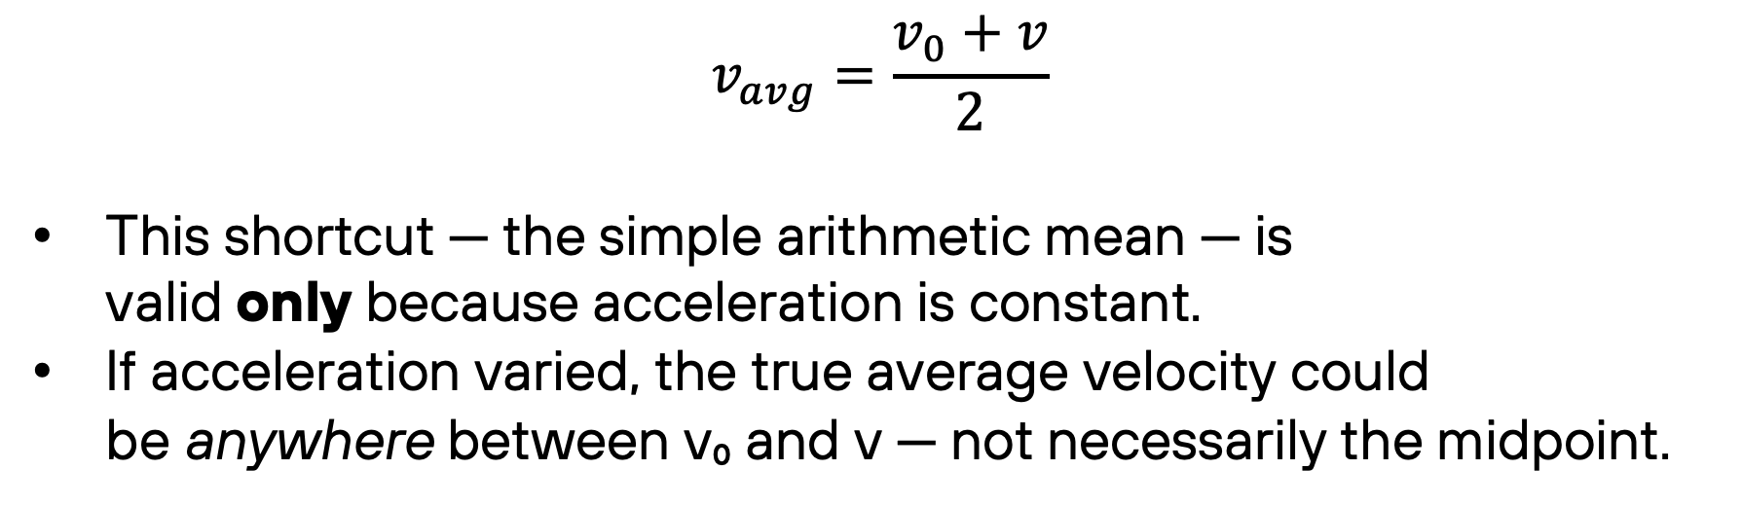
Average Velocity under
Constant Acceleration
$$v_{avg}=\frac{v_{0}+v}{2}$$
This shortcut — the simple arithmetic mean — is valid only because acceleration is constant.
If acceleration varied, the true average velocity could be anywhere between v₀ and v — not necessarily the midpoint.
Physics 1
Prepared by Engr. Philip Jayson L. Lestojas
Notes:
Walk through the formula slowly: subtract where you started from where you ended. Stress that displacement is blind to the journey — if a car drives forward, backs up, and ends up exactly where it started, its displacement is zero, no matter how much ground it actually covered.

Slide 13
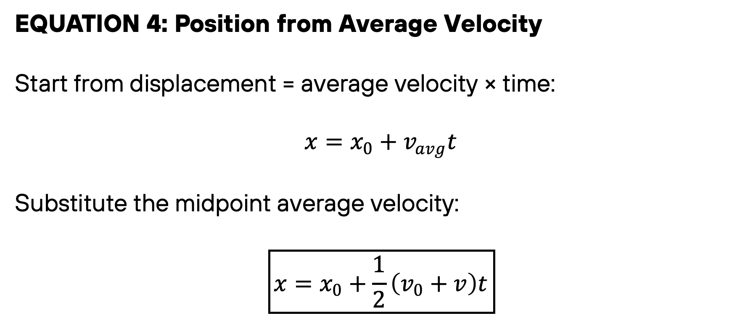
Deriving Equation 4
EQUATION 4: Position from Average Velocity
Start from displacement = average velocity × time:
$$x=x_{0}+v_{avg}t$$
Substitute the midpoint average velocity:
$$\boxed{x=x_{0}+\frac{1}{2}\left(v_{0}+v\right)t}$$
Physics 1
Prepared by Engr. Philip Jayson L. Lestojas
Notes:
Walk through the formula slowly: subtract where you started from where you ended. Stress that displacement is blind to the journey — if a car drives forward, backs up, and ends up exactly where it started, its displacement is zero, no matter how much ground it actually covered.

Slide 14
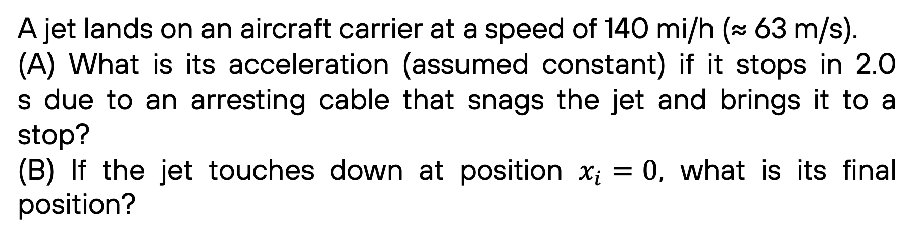
Guided Example 2
A jet lands on an aircraft carrier at a speed of 140 mi/h (≈ 63 m/s).
(A) What is its acceleration (assumed constant) if it stops in 2.0 s due to an arresting cable that snags the jet and brings it to a stop?
(B) If the jet touches down at position $x_{i}=0$, what is its final position?
Physics 1
Prepared by Engr. Philip Jayson L. Lestojas
Notes:
Walk through the formula slowly: subtract where you started from where you ended. Stress that displacement is blind to the journey — if a car drives forward, backs up, and ends up exactly where it started, its displacement is zero, no matter how much ground it actually covered.

Slide 15
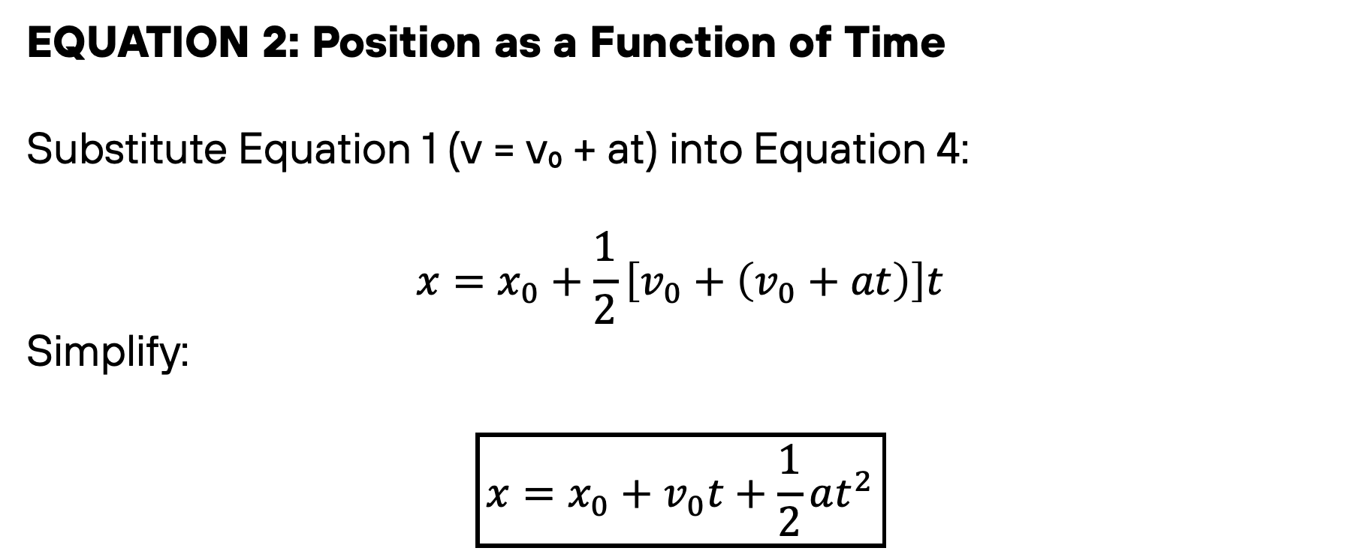
Deriving Equation 2
EQUATION 2: Position as a Function of Time
Substitute Equation 1 (v = v₀ + at) into Equation 4:
$$x=x_{0}+\frac{1}{2}\left[v_{0}+\left(v_{0}+at\right)\right]t$$
Simplify:
$$\boxed{x=x_{0}+v_{0}t+\frac{1}{2}at^{2}}$$
Physics 1
Prepared by Engr. Philip Jayson L. Lestojas
Notes:
Walk through the formula slowly: subtract where you started from where you ended. Stress that displacement is blind to the journey — if a car drives forward, backs up, and ends up exactly where it started, its displacement is zero, no matter how much ground it actually covered.

Slide 16
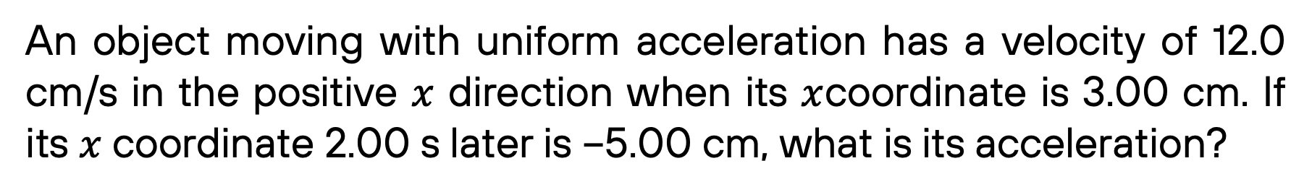
Guided Example 3
An object moving with uniform acceleration has a velocity of 12.0 cm/s in the positive $x$ direction when its $x$coordinate is 3.00 cm. If its $x$ coordinate 2.00 s later is −5.00 cm, what is its acceleration?
Physics 1
Prepared by Engr. Philip Jayson L. Lestojas
Notes:
Walk through the formula slowly: subtract where you started from where you ended. Stress that displacement is blind to the journey — if a car drives forward, backs up, and ends up exactly where it started, its displacement is zero, no matter how much ground it actually covered.

Slide 17
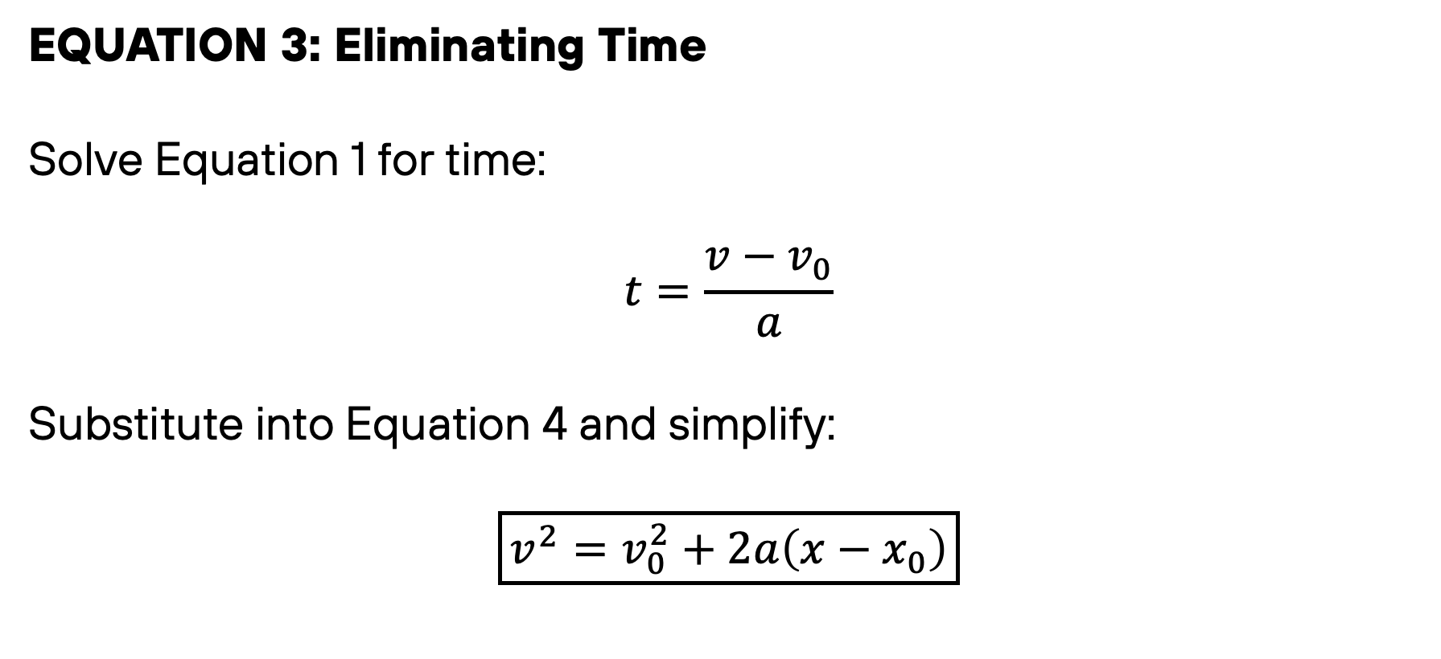
Deriving Equation 3
EQUATION 3: Eliminating Time
Solve Equation 1 for time:
$$t=\frac{v−v_{0}}{a}$$
Substitute into Equation 4 and simplify:
$$\boxed{v^{2}=v_{0}^{2}+2a\left(x−x_{0}\right)}$$
Physics 1
Prepared by Engr. Philip Jayson L. Lestojas
Notes:
Walk through the formula slowly: subtract where you started from where you ended. Stress that displacement is blind to the journey — if a car drives forward, backs up, and ends up exactly where it started, its displacement is zero, no matter how much ground it actually covered.

Slide 18
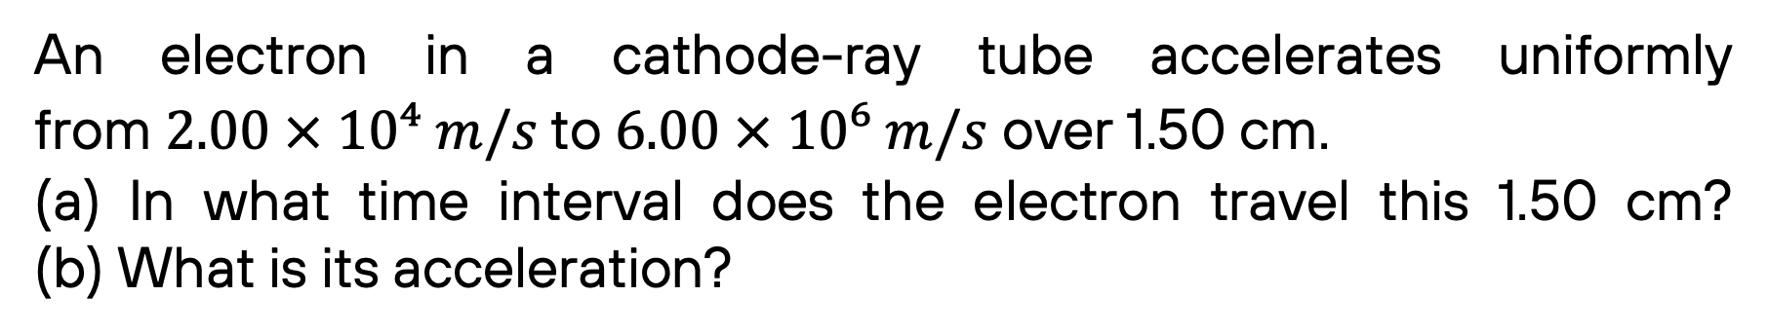
Guided Example 4
An electron in a cathode-ray tube accelerates uniformly from $2.00 × 10⁴ m/s$to $6.00 × 10⁶ m/s$ over 1.50 cm.
(a) In what time interval does the electron travel this 1.50 cm? (b) What is its acceleration?
Physics 1
Prepared by Engr. Philip Jayson L. Lestojas
Notes:
Walk through the formula slowly: subtract where you started from where you ended. Stress that displacement is blind to the journey — if a car drives forward, backs up, and ends up exactly where it started, its displacement is zero, no matter how much ground it actually covered.

